Slide 1
STERLING
E-COMMERCE

Slide 2
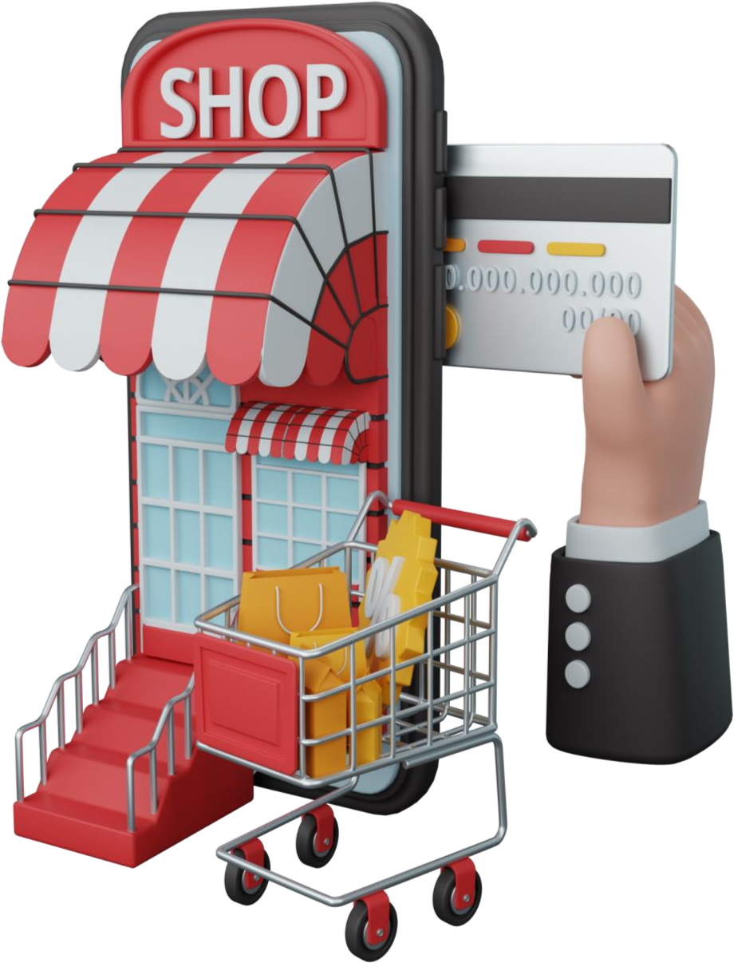
ABOUT COMPANY
Sterling E-Commerce is a one-stop online shopping destination for a wide range of high-quality products. Our mission is to provide our customers with the best shopping experience possible, with a focus on quality, affordability, and convenience.
At Sterling E-Commerce, we offer a wide selection of products across various categories such as health & sports, men's and women's fashion, computing, entertainment, mobiles & tablets, appliances, beauty & grooming, home & living, soghaat, school & education, books, and more. We pride ourselves on offering a comprehensive range of products that caters to the needs of our diverse customer base.
We are proud to be a leading e-commerce retailer, and we are committed to continuous innovation and improvement to meet the evolving needs of our customers.

Slide 3

PROBLEM OVERVIEW
The Director of Sterling are interested in leveraging the power of their data to gain insights into the business and improve their efficiency.
Sterling wants to better understand their customers' needs, preferences, and behavior. Specifically, want to identify any patterns or trends. Sterling believes that leveraging the power of data can help them make more informed decisions and boost effectiveness.
They want to understand their data, so they can optimize their product offerings, streamline operations, and enhance Sterling’s customer experience.

Slide 4

DATA DICTIONARY
Category – The category of goods
City – The city where customers are ordering from
County – The county where customers are ordering from
Cust Id – Customer ID
Customer Since – The date when the customer first order.
Date of Order – The date when the customer placed an order.
Full Name – Customer full name
Gender – (Male, Female)
Item Id – Item ID
Order Id – Order ID
Payment Method – The payment platform the customer used
Place Name – The exact location where the customer are ordering from
Ref Num – Reference Number
Region – The region where the customer are ordering from
State - The state where the customer are ordering from
User Name – The customer’s username
Zip – Customer’s zip code
Qty Ordered – The quantity of goods ordered
Total – Total amount paid by customer

Slide 5

PROJECT OBJECTIVE
To analyze order trends across different location.
To identify key performance indicators (KPIs) such as total revenue, Total customer, Total Goods Orders, Average Order Value and Total Order placed.
To understand customer purchasing behavior based on demographics and Product type.
To evaluate the frequently used payment methods-based item ordered.
To provide data-driven insights that will help improve Location focused operational efficiency and customer experience optimization

Slide 6
PROJECT WORKFLOW
DATASET CLEANING
PIVOT TABLE &
CHARTS
PUBLISH
&
SHARE
DASHBOARD

Slide 7

THE PLAN
The Dataset
Import the dataset
Join the tables
Observe the data types
Create the Charts
Derive the score card values
Plot the charts accordingly
Develop the Dashboard
Create and format the dashboard layout
Import the charts to the layout
Publish and share your Dashboard
DATASET CLEANING
PUBLISH & SHARE
PIVOT TABLE & CHARTS
DASHBOARD

Slide 8
STERLING ECOMMERCE DASHBOARD
CLICK HERE TO ACCESS THE DASHBOARD
DATASET CLEANING
PUBLISH & SHARE
PIVOT TABLE & CHARTS
DASHBOARD

Slide 9
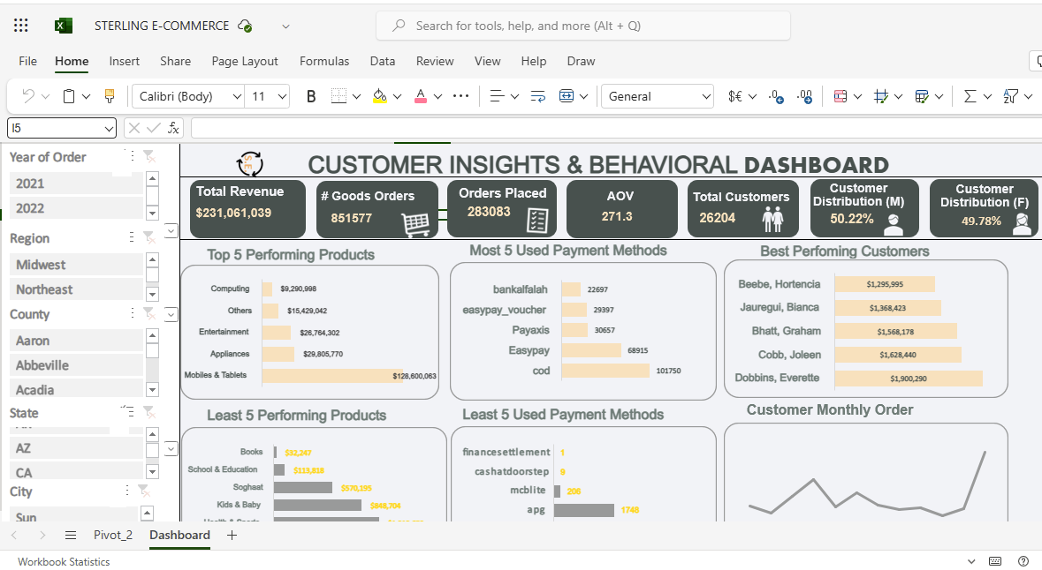
DATASET CLEANING
PUBLISH & SHARE
PIVOT TABLE & CHARTS
DASHBOARD

Slide 10
RECOMMENDATION AND INSIGHT
From observation, the company made more profit in the second year of its’ operation, than the initial year.
Mobile & Tablets are the most purchased products.
Books are the least purchased products.
Customers seem to gravitate towards using COD as the most preferred payment method.
The south region brought in the most revenue, with 6309 customers, and customers distribution was almost the same.
The West region had the least revenue. With 4655 customers, and similar customer distribution (Female slightly higher).

Slide 11

PROJECT CHALLENGE FACED
From observation, the company made more profit in the second year of its’ operation, than the initial year. Given the size of our dataset (which was quite large), it is advisable to create a separate sheet for the pivot table and dashboard.
This helps to prevent performance issues, such as a slow processor, which could increase the time required to complete the task.
We had to learn this while working as it wasn’t a practice we learnt in class.

